Slide 1



Slide 2
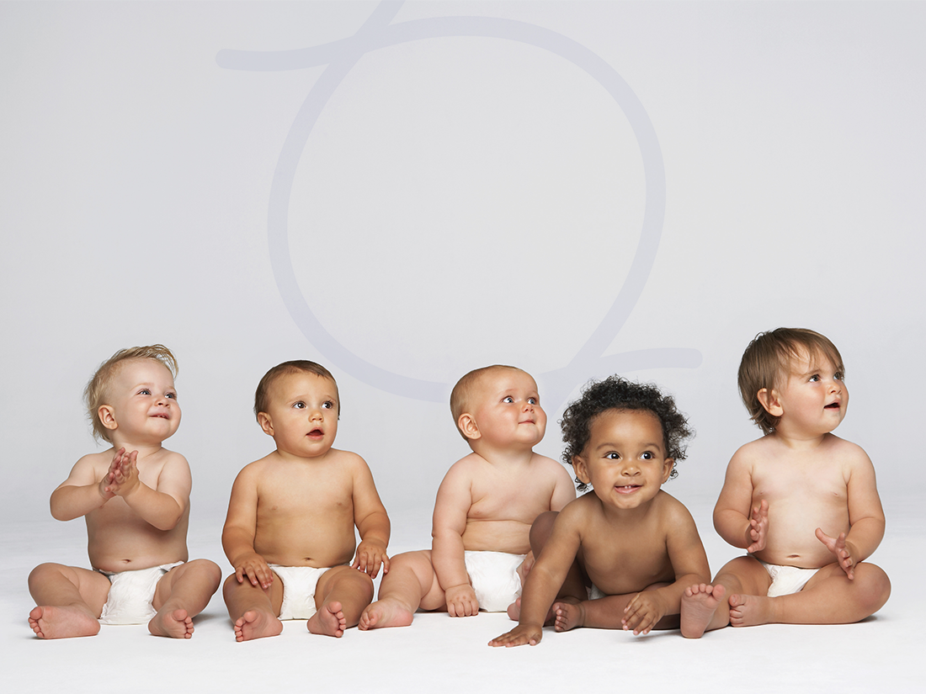
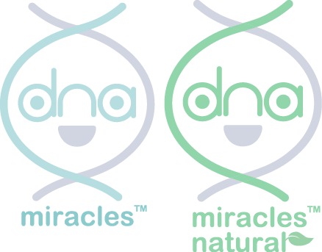

Slide 3
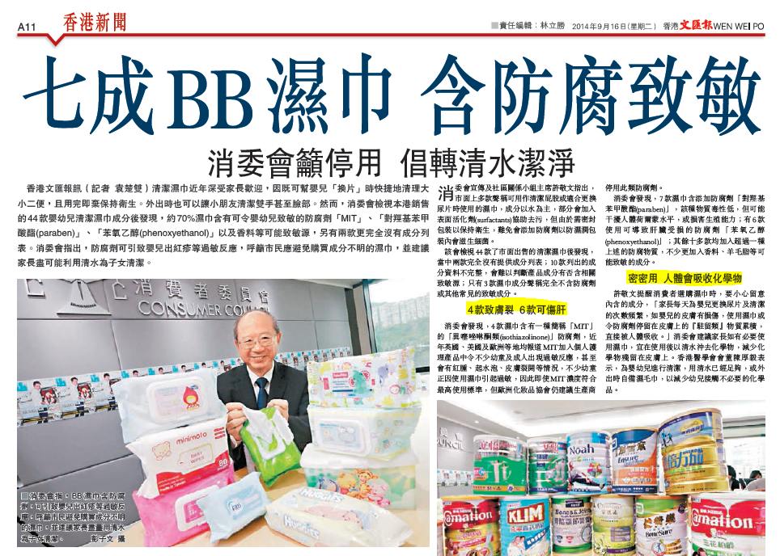
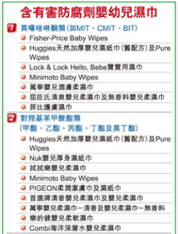
Preservative and Allergen Ingredients in 70% Baby Wipe Products
Notes:
http://pdf.wenweipo.com/2014/09/16/a11-0916.pdf

Slide 4

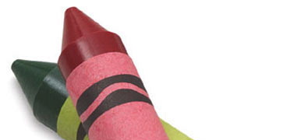
“燦爛開心的將來全賴健康的開始。
- DNA奇妙嬰兒系列
“Brighter days and better tomorrows only exist through healthy beginnings.”
-This is the DNA Way

Slide 5


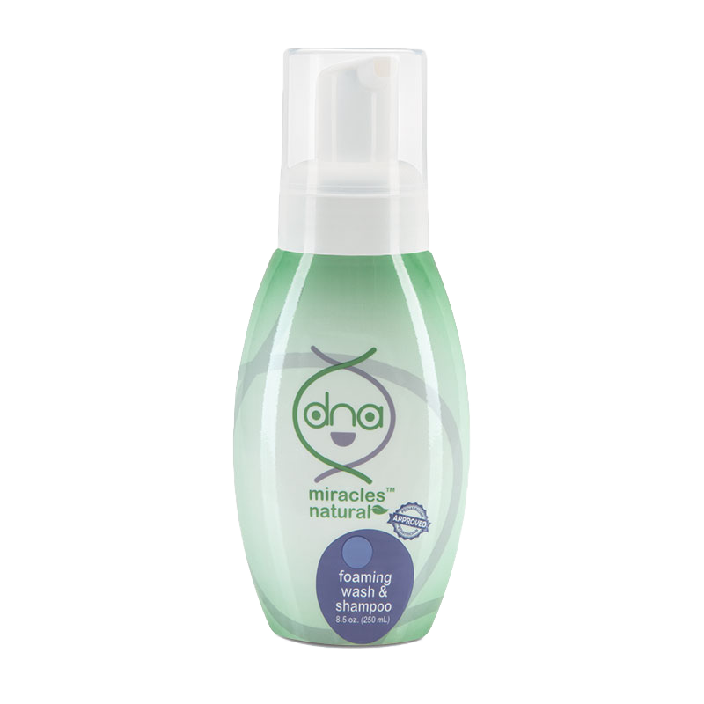
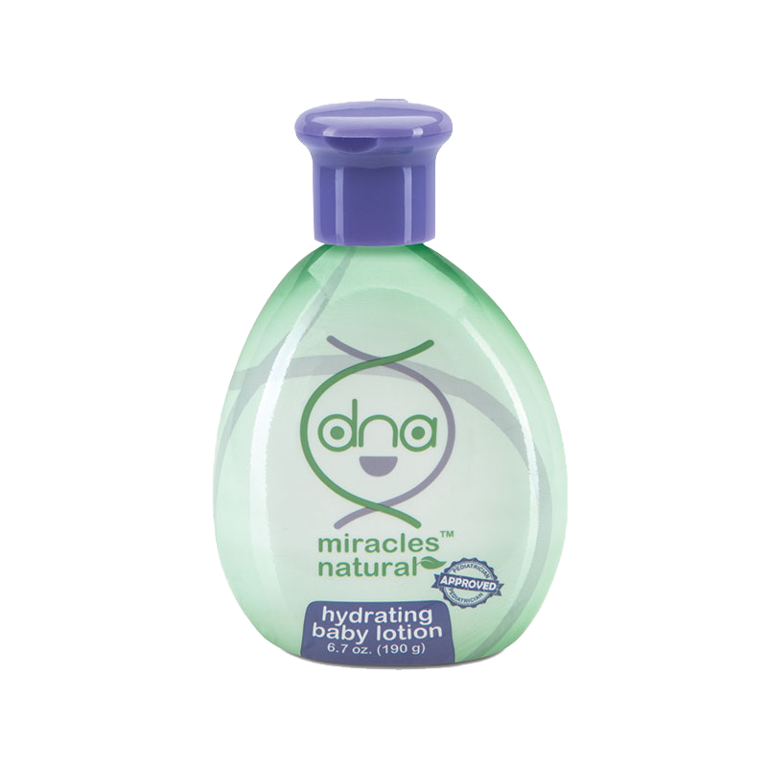
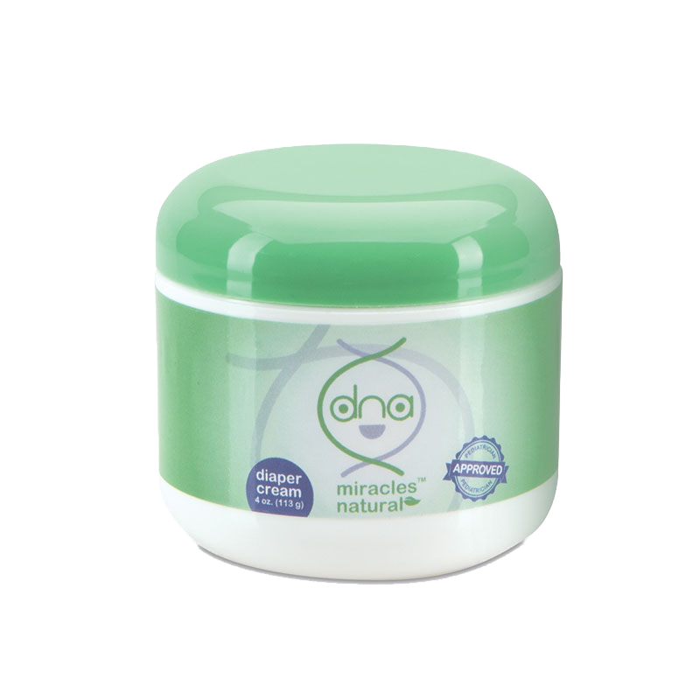
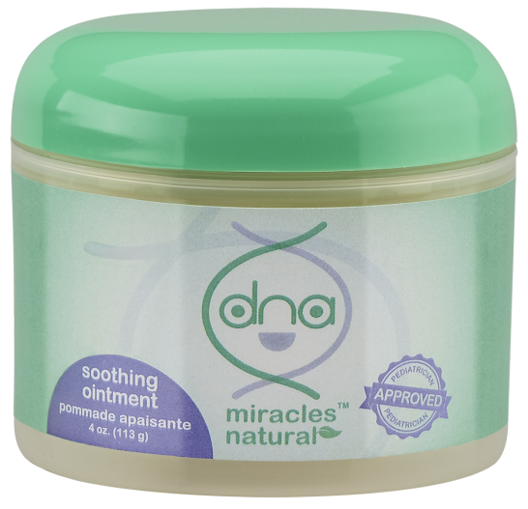

Slide 6
奇妙天然™洗髮沐浴泡泡
DNA Miracles™ Natural Foaming Wash & Shampoo
天然、溫和、無毒性的沐浴露，專為嬰兒細緻的皮膚和頭髮而設，適合初生嬰兒使用。
含有以椰子油製造的界面活性劑，能溫和潔淨皮膚與頭髮
滋潤並調理寶寶的頭髮
A natural, gentle, non-toxic body cleanser specially formulated for your baby's delicate skin and hair. Suitable for newborn use.
Gently cleanses the skin and hair with surfactants derived from coconut oil
Moisturize and conditions your baby’s hair
HK6932 | UC $81.00 | SR $113.00 | BV 6

Slide 7
奇妙天然™抗敏護膚膏
DNA Miracles™ Natural Diaper Cream
天然、無毒性的護膚膏，專為滋潤、紓緩和保護寶寶較敏感部位的肌膚而設。
有助防止輕微的皮膚刺激，令寶寶的皮膚柔嫩細滑
有助保濕、紓緩和保護寶寶的敏感肌膚
支援肌膚的正常防護功能，幫助肌膚保濕
A natural, non-toxic cream specially formulated to moisturize, soothe and protect your baby’s sensitive areas.
Helps insulate against minor skin irritation to keep your baby’s skin soft and smooth
Helps moisturize, soothe and protect your baby’s sensitive areas.
Supports normal skin barrier functions to help keep the skin hydrated.
HK6931 | UC $89.00 | SR $125.00 | BV 7.5

Slide 8
奇妙天然™潤膚乳液
DNA Miracles™ Natural Hydrating Baby Lotion
天然、無毒性的潤膚乳液，專為嬰兒敏感的面部與身體肌膚而設；性質溫和，適合初生嬰兒使用。
內含多種潤膚成份與草本植物萃取物，能為肌膚保濕，讓肌膚外表與觸感更細滑柔嫩
支援肌膚的正常防護功能，幫助肌膚保濕
有助紓緩肌膚輕微刺激
A natural, non-toxic body lotion specially formulated for your baby's face and body. Gentle on baby's sensitive skin and suitable for newborn use.
Moisturizes with a combination of emollients and herbal extracts for skin that looks and feels smoother and softer
Supports normal skin barrier functions to help keep the skin hydrated
Helps soothe minor skin irritations
HK6930 | UC $81.00 | SR $113.00 | BV 5.5

Slide 9
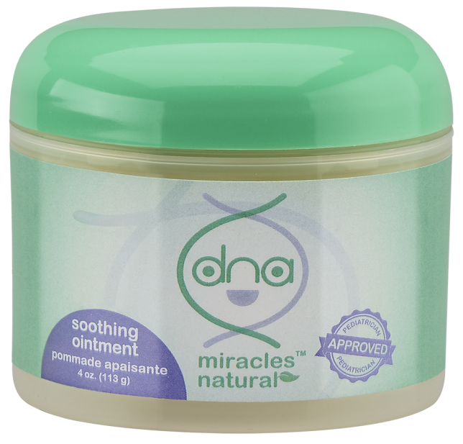
奇妙天然™舒緩膏
DNA Miracles™ Natural Soothing Ointment
配方絕無毒性，能有效紓緩肌膚，同時性質溫和，呵護最細緻柔嫩的肌膚。
有助紓緩肌膚
滋潤乾燥肌膚
鎖緊肌膚水分
含有天然成份，保護敏感肌膚
Nontoxic formula strong enough to soothe and yet gentle enough for the softest skin.
Helps soothe skin
Moisturizes dry skin areas
Locks in moisture
Uses natural ingredients to protect sensitive skin
HK6930 | UC $122.00 | SR $170.00 | BV 10

Slide 10
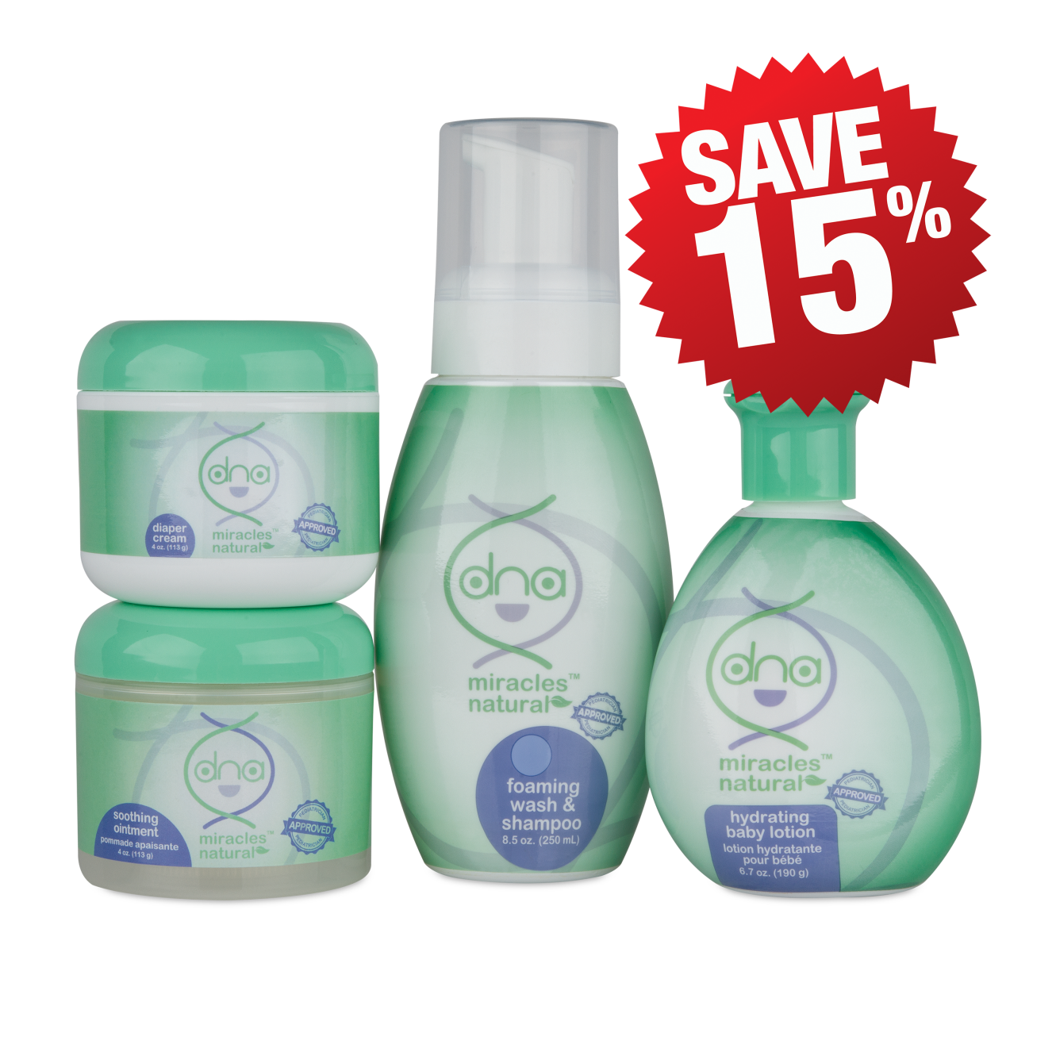
奇妙天然™系列套裝
DNA Miracles™ Natural Value Kit
HK6934 | UC $254.00 | SR $355.00 | BV 13.5

Slide 11

即將推出！
COMING SOON!

Slide 12




Slide 13
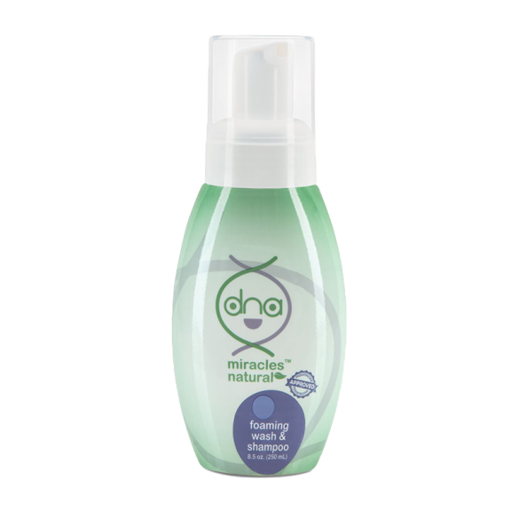
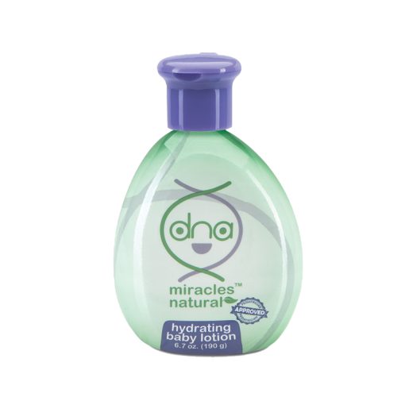
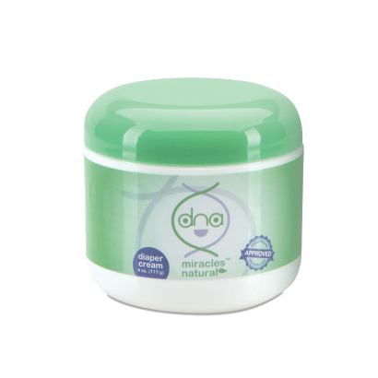

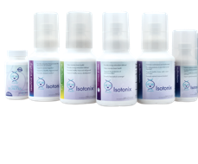
奇妙系列
DNA Miracles™

Slide 14
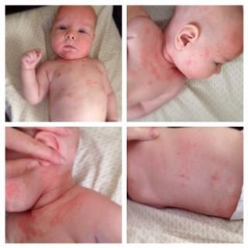
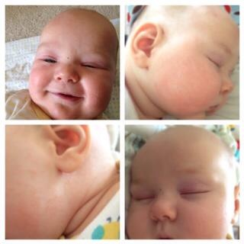
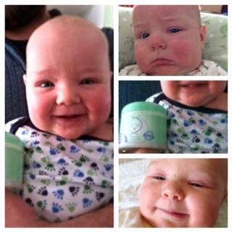
見証分享 TESTIMONIALS
奇妙天然舒緩膏
我的兒子在3個月大時患上了可怕的濕疹。當時我們嘗試了許多產品，甚至從他的飲食著手，情況卻毫無改善，甚至不斷惡化！直到我的DNA奇妙天然舒緩膏訂單抵達。我把舒緩膏從頭到腳、仔細地塗抹兒子全身。在12小時之內，濕疹情況明顯改善。真是一個奇蹟！
NATURAL SOOTHING OINTMENT
My son has had terrible eczema for over a month (he's 3 months old). We have tried many products and even changing his diet. It just keeps getting worse!!! Until my DNA Miracles Soothing Ointment order arrived Friday. I've been slathering him head to toe. It started to clear up VERY noticeably within less than 12 hours. Miracles indeed!!!
－Sarah B

Slide 15
DNA Miracles™ Natural Hydrating Baby Lotion
見証分享 TESTIMONIALS
DNA奇妙天然潤膚乳液十分好用！
我女兒最喜歡的「遊戲」，就是洗澡後塗上潤膚乳液。對我們來說這是一個有趣的親子時間，我們真的很喜歡這潤膚乳液的溫和、宜人香味。我女兒也喜歡游泳。而我最愛DNA 奇妙天然潤膚乳液的就是，潤膚乳液可以滋潤她每天暴露在陽光下的肌膚，而晚上她睡覺時，我和丈夫都很喜歡邊親吻、邊聞她身上散發的香氣，向她說晚安。這就是我們間的甜蜜時光！
The DNA Miracles Natural Hydrating Lotion is wonderful!
My daughter's favorite "game" is to put DNA lotion on herself after her bath. It's a fun time for us and we really like the mild pleasant smell of the lotion. She also loves going swimming. I love the fact that DNA lotion can moisture her skin after exposure to the sun every day, and when she's in bed with this nice smell all over her, my husband and I love to smell and kiss her all over. What a sweet time!
We Love DNA Miracles!
Maple -Taiwan

Slide 16
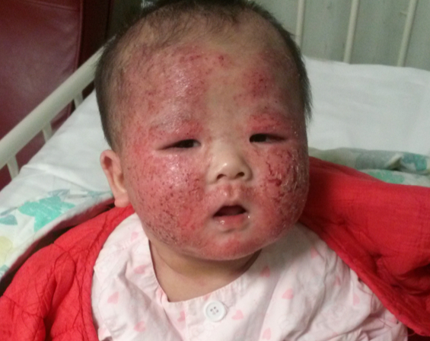
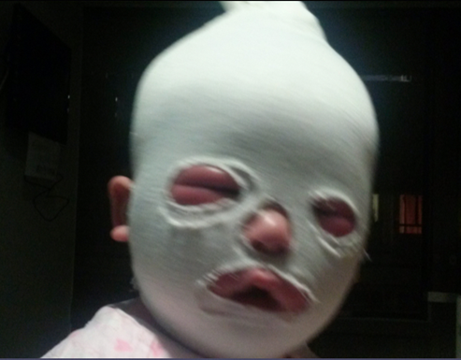
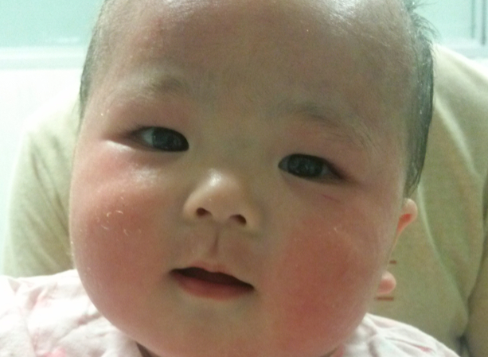
見証分享 TESTIMONIALS
9個月大的JACOB，皮膚失去鎖水功能。
Jacob’s skin was unable to restore water when he was 9 months old.

Slide 17
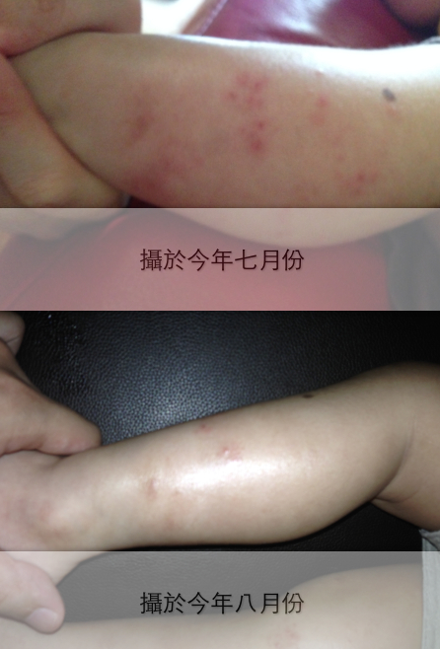
見証分享 TESTIMONIALS
使用DNA奇妙嬰兒天然舒緩膏後…
After using DNA Miracles Natural Soothing Ointment…

Slide 18

見証分享 TESTIMONIALS

Slide 19
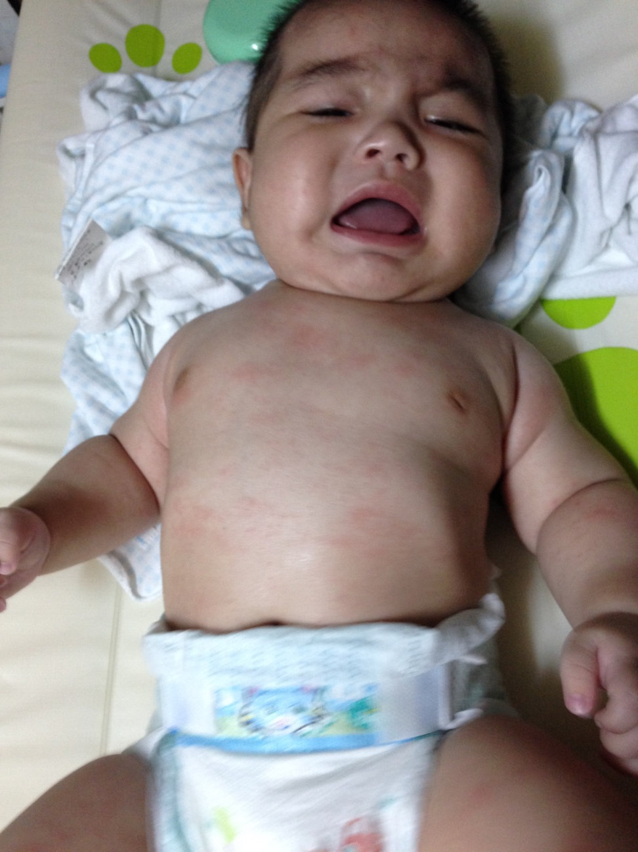
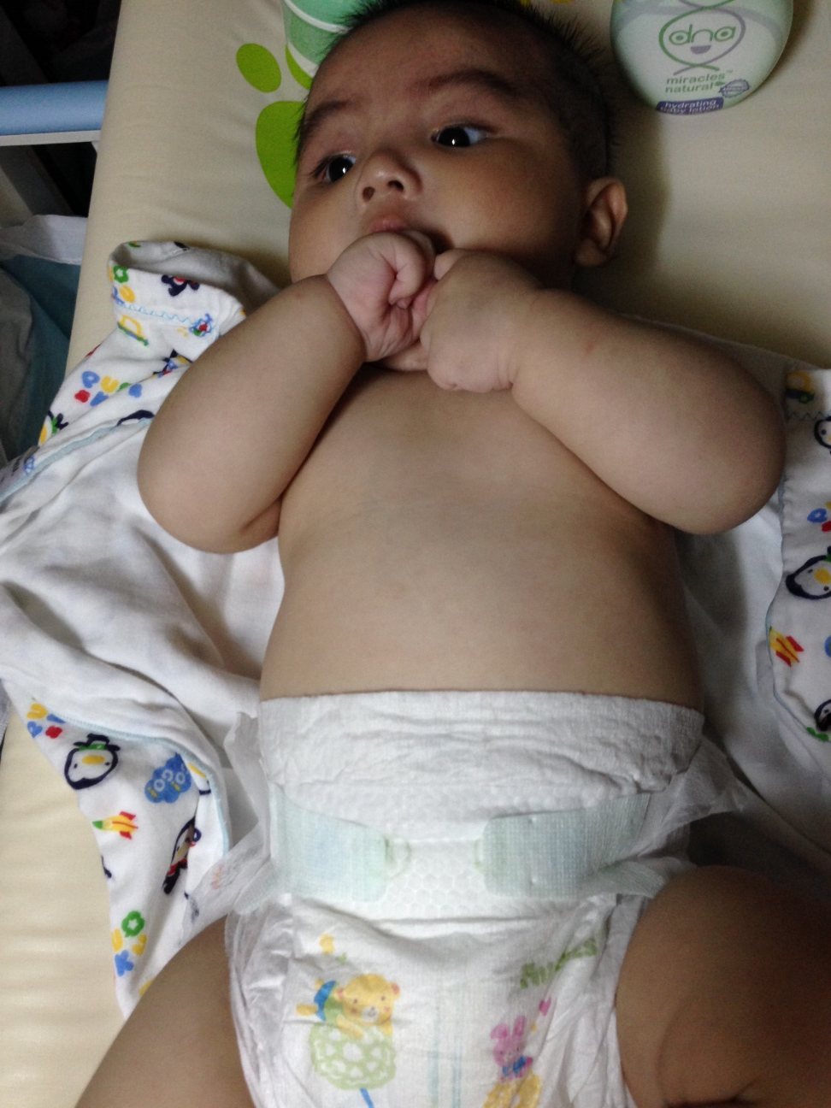
見証分享 TESTIMONIALS

Slide 20
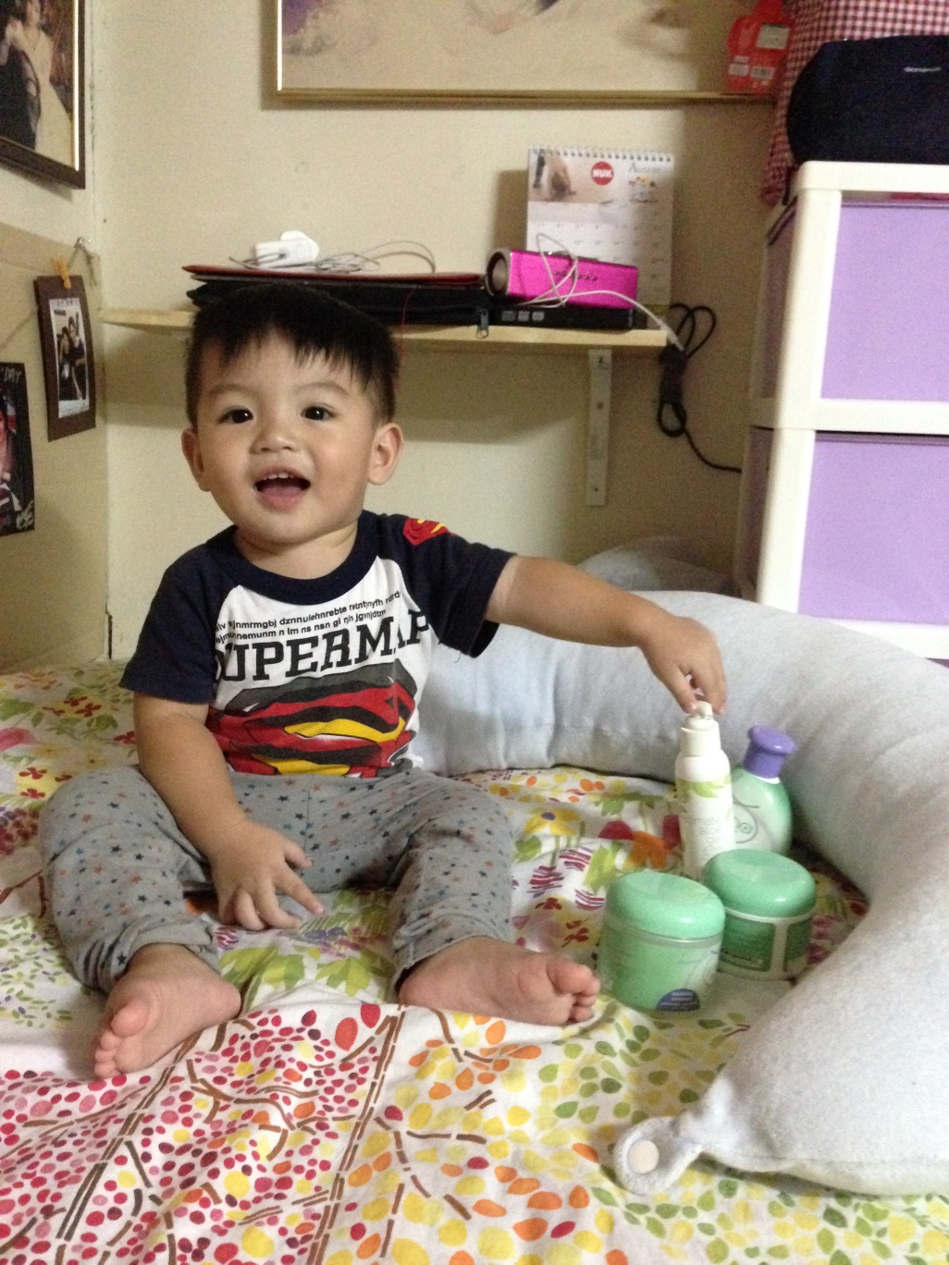
見証分享 TESTIMONIALS
喜愛DNA系列天然植物性成份，絕不含刺激的化學物質，尤其洗髮沐浴泡泡方便使用，又可當泡泡浴不用過水，令BB丶媽媽更多親密時間！
Love the natural ingredients in DNA Miracle products. They do not carry harsh and unnecessary chemicals. I love their Foaming Wash & Shampoo because it is convenient to use. It adds up quality time between me and my lovely angel!

Slide 21
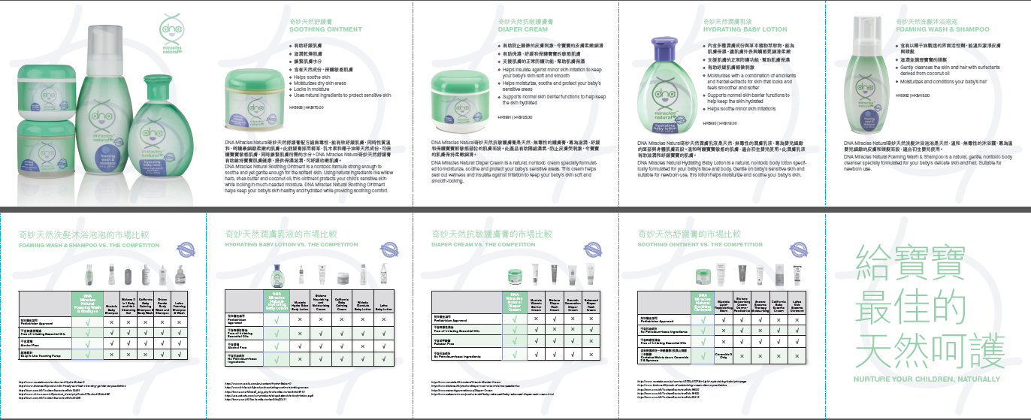
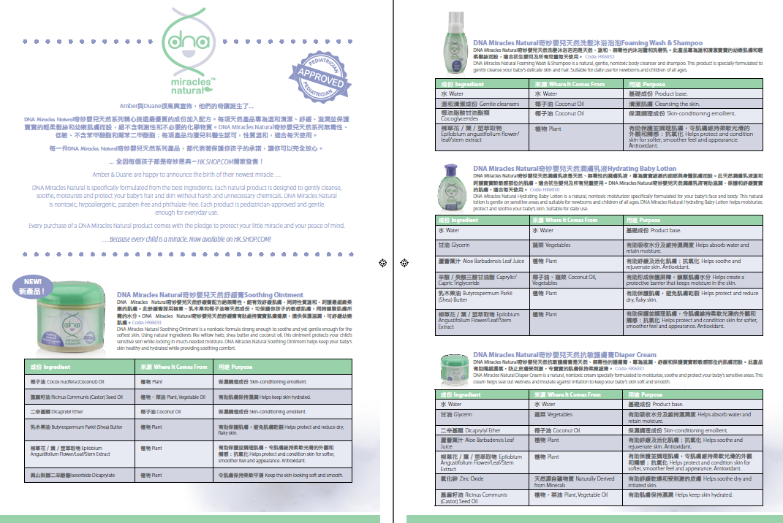
產品單張
Leaflet
下載產品單張
Downloadable Leaflet

Slide 22


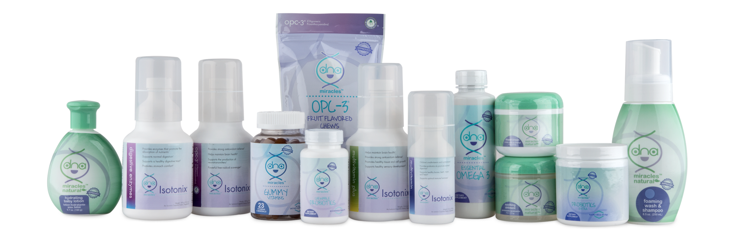

Slide 23

.
Notes:
23

